Slide 1
Testing Concepts
Lesson 4: Test Techniques

Slide 2
Lesson Objectives
To understand the following topics:
Categories of Test Techniques
Choosing Test Techniques
Categories of Test Techniques & their Characteristics
Black-box Test Techniques
Equivalence Partitioning
Boundary Value Analysis
Decision Table Testing
State Transition Testing
Use Case Testing

Slide 3
Lesson Objectives
White-box Test Techniques
Statement Testing and Coverage
Decision Testing and Coverage
The Value of Statement and Decision Testing
Experience-based Test Techniques
Error Guessing
Exploratory Testing
Checklist-based Testing

Slide 4
4.1 Categories of Dynamic Test Techniques
Dynamic Testing involves working with the software, giving input
values and validating the output with the expected outcome
Dynamic Testing is performed by executing the code
It checks for functional behavior of software system , memory/CPU
usage and overall performance of the system
Dynamic Testing focuses on whether the software product works in conformance with the business requirements
Dynamic testing is performed at all levels of testing and it can be either black or white box testing

Slide 5
Categories of Dynamic Test Techniques (Cont..)
White Box Test Techniques
Code Coverage
Statement Coverage
Decision Coverage
Condition Coverage
Loop Testing
Code complexity
Cyclomatic Complexity
Memory Leakage
Black Box Test Techniques
Equivalence Partitioning
Boundary Value Analysis
Use Case / UML
Error Guessing
Cause-Effect Graphing
State Transition Testing

Slide 6
4.1.1 Choosing Test Techniques
The choice of which test techniques to use depends on a number of factors :
Type of component or system
Component or system complexity
Regulatory standards
Customer or contractual requirements
Risk levels & Risk types
Test objectives
Available documentation
Tester knowledge and skills
Available tools
Time and budget
SDLC model
Expected use of the software
Previous experience with using the test techniques on the component or
system to be tested
The types of defects expected in the component or system

Slide 7
4.1.2 Categories of Test Techniques & their Characteristics
Black-box test techniques
It is a.k.a. behavioral/behavior-based techniques are based on an analysis of the appropriate test basis (e.g., formal requirements documents, specifications, use cases, user stories, or business processes).
These concentrate on the inputs and outputs of the test object without reference to its internal structure.
These techniques are applicable to both functional and nonfunctional testing.
White-box test techniques
It is a.k.a. structural/structure-based techniques are based on an analysis of the architecture, detailed design, internal structure, or the code of the test object.
These concentrate on the structure and processing within the test object.
Experience-based test techniques
These leverage the experience of developers, testers and users to design,
implement, and execute tests.
These techniques are often combined with black-box and white-box test
techniques.

Slide 8
Characteristics of Black-box Test Techniques
Test conditions, test cases, and test data are derived from a test basis that may include software requirements, specifications, use cases, and user stories
Test cases may be used to detect gaps between the requirements and the implementation of the requirements, as well as deviations from the requirements
Coverage is measured based on the items tested in the test basis and the technique applied to the test basis

Slide 9
Characteristics of White-box Test Techniques
Test conditions, test cases, and test data are derived from a test basis that may include code, software architecture, detailed design, or any other source of information regarding the structure of the software
Coverage is measured based on the items tested within a selected
structure (e.g., the code or interfaces)
Specifications are often used as an additional source of information to determine the expected outcome of test cases

Slide 10
Characteristics of Experience-box Test Techniques
Test conditions, test cases, and test data are derived from a test basis that may include knowledge and experience of testers, developers, users and other stakeholders.
This knowledge and experience includes expected use of the software, its environment, likely defects, and the distribution of those defects

Slide 11
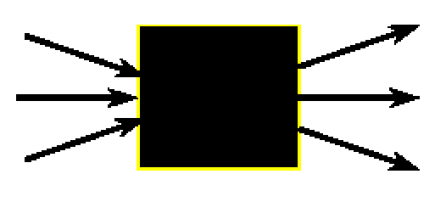
4.2 Black Box Test Techniques
Black box is data-driven, or input/output-driven testing
The Test Engineer is completely unconcerned about the internal behavior and structure of program
Black box testing is also known as behavioral, functional, opaque-box
and closed-box
Black Box can be applied at different Test Levels – Unit, Subsystem and
System.
Input
Output

Slide 12
Black Box Test Techniques
There are various techniques to perform Black box testing ;
Equivalence Partitioning
Boundary Value Analysis
Decision Table Testing
State transition testing
Use Case Testing
Error Guessing

Slide 13
4.2.1 Equivalence Partitioning
Equivalence partitioning divides data into partitions called as equivalence classes in such a way that all the members of a given partition are expected to be processed in the same way.
There are equivalence partitions for both valid and invalid values.
Valid values are values accepted by the component or system. An equivalence
partition containing valid values is called a “valid equivalence partition.”
Invalid values are values rejected by the component or system. An equivalence partition containing invalid values is called an “invalid equivalence partition.”
Partitions can be identified for any data element related to the test object, including inputs, outputs, internal values, time-related values (e.g., before or after an event) and for interface parameters (e.g., integrated components being tested during integration testing).
Assumption: If one value in a group works, all will work. One from each partition is better than all from one.

Slide 14
Guidelines & Examples to identify Equivalence Classes
1. If an input condition specifies a continuous range of values, there is one valid class, and two invalid classes
E.g. The valid range of a mortgage applicant’s income is $1000 - $75,000
Valid class: {1000 > = income < = 75,000}
Invalid classes: {income < 1000}, {income > 75,000}
2. If an input condition specifies a set of values, there is reason to believe
that each is handled differently in the program.
E.g. Type of Vehicle must be Bus, Truck, Taxi). A valid equivalence class would be any one of the values and invalid class would be say Trailer or Van.
3. If a “must be” condition is required, there is one valid equivalence class
and one invalid class
E.g. The mortgage applicant must be a person Valid class: {person}
Invalid classes:{corporation, ...anything else...}

Slide 15


Examples: Equivalence Partitioning
If an input condition specifies that a variable, say count, can take range of values(1 - 999). There is one valid equivalence class (1 < count < 999) and two invalid equivalence classes (count < 1) & (count
>999)
0
999
1000
1

Slide 16
4.2.2 Boundary Value Analysis
“Bugs lurk in corners and congregate at boundaries …..” Boris Beizer
Boundary Conditions are those situations directly on, above, and beneath the edges of input equivalence classes and output equivalence classes.
Boundary value analysis is a test case design technique that complements Equivalence partitioning but can only be used when the partition is ordered, consisting of numeric or sequential data. The minimum and maximum values (or first and last values) of a partition are its boundary values.
Test cases at the boundary of each input Includes the values at the
boundary, just below the boundary and just above the boundary.

Slide 17
Guidelines & Examples for Boundary Value Analysis
E.g. From previous example, we have valid equivalence class as (1 < count < 999). Now, according to boundary value analysis, we need to write test cases for count=0, count=1,count=2,count=998,count=999 and count=1000 respectively.
0
2
998
1000
1
999
E.g. If we have to test the function int Max(int a , int b) the Boundary Values for the arguments of the functions will be :
Arguments Valid Values Invalid Values
a | -32768, -32767, 32767, 32766 | -32769,32768
b | -32768, -32767, 32767, 32766 | -32769,32768

Slide 18
4.2.3 Decision Table Testing
Decision Testing is useful for testing the implementation of system requirements that specify how different combinations of conditions result in different outcomes.
When creating decision tables, the tester identifies conditions (often inputs) and the resulting actions (often outputs) of the system.
These form the rows of the table, usually with the conditions at the top and the
actions at the bottom.
Each column corresponds to a decision rule that defines a unique combination of conditions which results in the execution of the actions associated with that rule.
The values of the conditions and actions are usually shown as Boolean values
(true or false) or can also be numbers or ranges of numbers.

Slide 19
Notations in Decision Tables
The common notation in decision tables is as follows:
For conditions:
Y means the condition is true (may also be shown as T or 1)
N means the condition is false (may also be shown as F or 0)
— means the value of the condition doesn’t matter (may also be shown as N/A)
For actions:
X means the action should occur (may also be shown as Y or T or 1)
Blank means the action should not occur (may also be shown as – or N or F or 0)

Slide 20
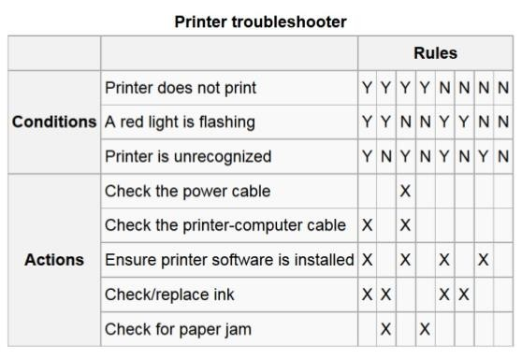
Example of Decision Table

Slide 21
Advantages of Decision Table Testing
The strength of decision table testing is that it helps to identify all the important combinations of conditions, some of which might otherwise be overlooked.
It also helps in finding any gaps in the requirements.
It may be applied to all situations in which the behavior of the software
depends on a combination of conditions, at any test level.

Slide 22
4.2.4 State Transition Testing
A state transition diagram shows the possible software states, as well as how the software enters, exits, and transitions between states.
A transition is initiated by an event (e.g., user input of a value into a field). The event results in a transition.
If the same event can result in two or more different transitions from the same state, that event may be qualified by a guard condition.
The state change may result in the software taking an action (e.g., outputting a calculation or error message).
Example :
The State Transition testing is used for Menu-based application.
The program starts with an introductory menu. As an option is selected the program changes state and displays a new menu. Eventually it displays some information , data input screen.
Each option in each menu should be tested to validate that each selection made takes us to the state we should reach next.

Slide 23
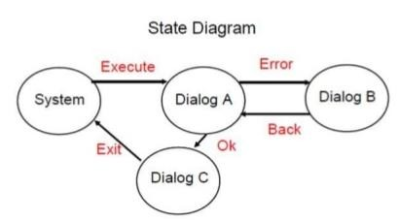
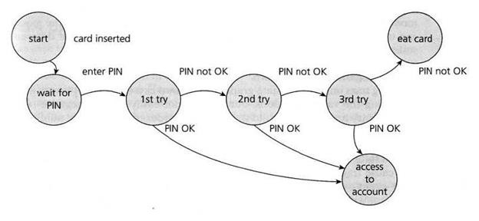
Guidelines & Examples of State Transition Testing

Slide 24
4.2.5 Use Case Testing
Tests can be derived from use cases, which are a specific way of designing interactions with software items, incorporating requirements for the software functions represented by the use cases.
Use cases are associated with actors (human users, external hardware, or other components or systems) and subjects (the component or system to which the use case is applied).
Each use case specifies some behavior that a subject can perform in collaboration with one or more actors.
A use case can be described by interactions and activities, as well as
preconditions, post conditions and natural language where appropriate.
Interactions between the actors and the subject may result in changes
to the state of the subject.

Slide 25
4.3 White Box Test Techniques
White box is logic driven testing and permits Test Engineer to examine the internal structure of the program
Examine paths in the implementation
Make sure that each statement, decision branch, or path is tested with at least
one test case.
Desirable to use tools to analyze and track Coverage
White box testing is also known as structural, glass-box and clear-box
There are various techniques to perform Black box testing ;
Code Coverage
Statement Testing and Coverage
Decision Testing and Coverage
Condition Testing and Coverage
Code complexity

Slide 26

4.3.1 Statement Coverage
Test cases must be such that all statements in the program is
least once.
Example :
Consider the following snippet of code
void procedure(int a, int b, int x)
{
If (a>1) && (b==0)
{ x=x/a; } //statement 1
If (a==2) || (x>1)
traversed at
{ x=x+1; } //statement 2
}
Coverage is measured as the number of statements executed by the tests divided by the total number of executable statements in the test object, normally expressed as a percentage.

Slide 27
Statement Coverage
Test Case 1: a=2,b=0, x=3.
Every statement will be executed once.
One test case is sufficient to execute all the statements in the code.
A
a > 1
AND
b = 0
C
Yes
No B
x=x/a
a = 2
Or
x > 1
No
D
Yes E
x=x+1

Slide 28
4.3.2 Decision Coverage
Test Case 1: a=2, b=0, x>1
(Decision1 is True, Decision2 is True) (Path ACE)
A
a > 1
AND
b = 0
C
Yes
No B
x=x/a
Test Case 2: a<=1 , b!=0, x<=1
(Decision1 is False, Decision2 is False) (Path ABD).
Two test cases are sufficient to test all decisions – every decision should be tested at least once for both TRUE and FALSE sides.
a = 2 Or
x > 1
No
D
Yes E
x=x+1

Slide 29
4.3.3 Value of Statement and Decision Testing
When 100% statement coverage is achieved, it ensures that all executable statements in the code have been tested at least once, but it does not ensure that all decision logic has been tested. Statement testing provides less coverage than decision testing.
When 100% decision coverage is achieved, it executes all decision outcomes, which includes testing the true outcome and also the false outcome, even when there is no explicit false statement (e.g., in the case of an IF statement without an else in the code).
Statement coverage helps to find defects in code that was not exercised by other tests. Decision coverage helps to find defects in code where other tests have not taken both true and false outcomes.
Achieving 100% decision coverage guarantees 100% statement
coverage.

Slide 30
4.3.4 Condition Coverage
Test cases are written such that each condition in a decision takes on all possible outcomes at least once.
A
a > 1
AND
b = 0
Yes
C
Test Case1 : a=2, b=0, x=3 (Condition1
is True,Condn2 is True)
(Path ACE)
Test Case2 : a=3, b=0, x=0
(Condn1 is True,Condn2 is False,Condn3
is False)
(Path ACD)
Test Case3 : a=1, b=0, x=3
(Condition1 is False,Condition2 is True) (Path ABE)
Test Case4: a=1, b=1, x=1 (Condition1 is False,Condition2 is False)
(Path ABD)
No B
x=x/a
a = 2 Or
x > 1
No
D
Yes
E
x=x+1

Slide 31
Condition Coverage
ACE
A
ABD
A
ABE
A
ACD
A
a>1 && b=0
a>1 && b=0
C
a>1 && b=0
C
a>1 && b=0
C
C
x=x/a
x=x/a
x=x/a
B
x=x/a
B
B
B
a=2
|| x>1
a=2
|| x>1
E
a=2
|| x>1
E
a=2
||
x>1
E
E
x=x/b
x=x/b
x=x/b
D
x=x/b
D
D
D
a=2, b=0, x=3
a=1, b=0, x=0
a=1, b=0, x=3
a=3, b=0, x=0

Slide 32
Cyclomatic Complexity
Cyclomatic Complexity (Code Complexity) is a software metric that provides a quantitative measure of logical complexity of a program
When Used in the context of the basis path testing method, value for cyclomatic complexity defines number of independent paths in basis set of a program
Also provides an upper bound for the number of tests that must be conducted to ensure that all statements have been executed at least once
Cyclomatic complexity is often referred to simply as program
complexity, or as McCabe's complexity

Slide 33
Calculating Cyclomatic Complexity
The cyclomatic complexity of a software module is calculated from a flow graph of the module , when used in context of the basis path testing method
Cyclomatic Complexity V(G) is calculated one of the three ways:
V(G) = E - N + 2 , where E is the number of edges and N = the number of nodes of the graph
V(G) = P+1, where P is the number of predicate nodes
V(G) = R , where number of region in the graph

Slide 34
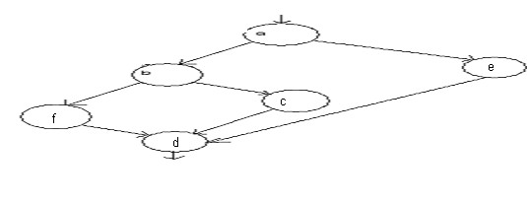
Calculating Cyclomatic Complexity : Example
In the given figure a and b are predicate nodes
Cyclomatic Complexity, V(G) for a flow Graph G is V(G) = E – N + 2 E = Number of Edges in the graph (7 in the above figure)
N = number of flow graph Nodes (6) R = number of Regions (3)
Hence V(G) = 7-6+2 = 3
V(G) can also be calculated as V(G) = P+1, where P is the number of predicate nodes. Here V(G) = 2+1 = 3
Also V(G) can be calculated as V(G) = R hence V(G) = 3

Slide 35
4.4 Experience-based Test Techniques
When applying experience-based test techniques, the test cases are derived from the tester’s skill and intuition, and their experience with similar applications and technologies.
These techniques can be helpful in identifying tests that were not easily identified by other more systematic techniques.
Depending on the tester’s approach and experience, these techniques may
achieve widely varying degrees of coverage and effectiveness.
Coverage can be difficult to assess and may not be measurable with these techniques.
Commonly used experience-based techniques are
Error Guessing
Exploratory Testing
Checklist-based Testing

Slide 36
4.4.1 Error Guessing
It is an ad hoc approach
Error guessing is a technique used to anticipate the occurrence of mistakes,
defects, and failures, based on the tester’s knowledge, including:
How the application has worked in the past
What types of mistakes the developers tend to make
Failures that have occurred in other applications
A methodical approach to the error guessing technique is to create a list of possible mistakes, defects, and failures, and design tests that will expose those failures and the defects that caused them.
Example :
Suppose we have to test the login screen of an application. An experienced test engineer may immediately see if the password typed in the password field can be copied to a text field which may cause a breach in the security of the application.

Slide 37
4.4.2 Exploratory Testing
In exploratory testing, informal (not pre-defined) tests are designed, executed, logged, and evaluated dynamically during test execution.
The test results are used to learn more about the component or system, and to
create tests for the areas that may need more testing.
Exploratory testing is sometimes conducted using session-based testing to structure the activity.
Exploratory testing is most useful when there are few or inadequate
specifications or significant time pressure on testing.
Exploratory testing is also useful to complement other more formal testing techniques. Exploratory testing is strongly associated with reactive test strategies (see section 5.2.2). Exploratory testing can incorporate the use of other black-box, white-box, and experience-based techniques.

Slide 38
4.4.3 Checklist-based Testing
In checklist-based testing, testers design, implement, and execute tests to cover test conditions found in a checklist.
As part of analysis, testers create a new checklist or expand an existing
checklist, but testers may also use an existing checklist without modification.
Such checklists can be built based on experience, knowledge about what is important for the user, or an understanding of why and how software fails.
Checklists can be created to support various test types, including functional and
non-functional testing.
In the absence of detailed test cases, checklist-based testing can provide
guidelines and a degree of consistency.
As these are high-level lists, some variability in the actual testing is likely to
occur, resulting in potentially greater coverage but less repeatability.

Slide 39
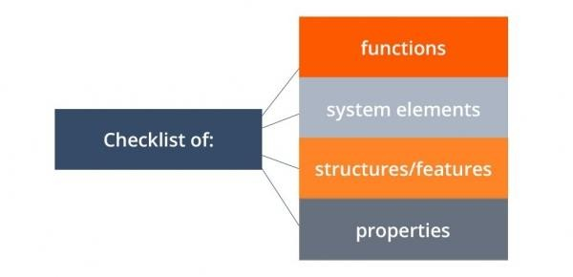
Commonly used Testing Checklists
Check-list based Technique

Slide 40
Advantages of using checklists in testing
Flexibility.
Easy to create.
Analyzing the results.
Team integration.
Deadlines control.
Test case reusability can help in cutting down costs incurred in missing
out on important testing aspects.
innovative testing strategy can be added in the testing checklist.

Slide 41
Difficulties of using checklists in testing
Different interpretation
Difficulty in Test results reproducibility
“Holes” in coverage.
Item overlap.
Reporting problems.

Slide 42
Summary
In this lesson, you have learnt:
The test case techniques discussed so far need to be combined to form overall
strategy
Each technique contributes a set of useful test cases, but none of them by itself
contributes a thorough set of test cases

Slide 43

Review Question
Question 1: For calculating cyclomatic complexity, flow graph is mapped into corresponding flow chart
Option: True / False
Question 2: How many minimum test cases required to
test a simple loop?
Question 3: Incorrect form of logic coverage is :
Statement coverage
Pole coverage
Condition coverage
Path coverage
Question 4: One test condition will have test cases.

Slide 44
Review Question
Question 5: For Agile development model conventional testing approach is followed.
Option: True / False
Question 6: A test case is a set of ,
, and developed for a
particular objective.
Question 7: An input field takes the year of birth between 1900 and 2004. State the boundary values for testing this field.
0, 1900,2004,2005
1900, 2004
1899, 1900, 2004, 2005
1899, 1900, 1901, 2003, 2004, 2005

Slide 45
Review Question: Match the Following
A. Flow graph
B. Loop testing
C. Black box testing
D. Flow chart
E. Condition testing
F. White box testing
1. Code coverage
2. Interface errors
3. Code complexity

